Slide 1
20 Years of Quasar Variability
Geoffrey C. Bower
Sofia Wallstrom
Jason Dexter
Steve Mairs

Slide 2
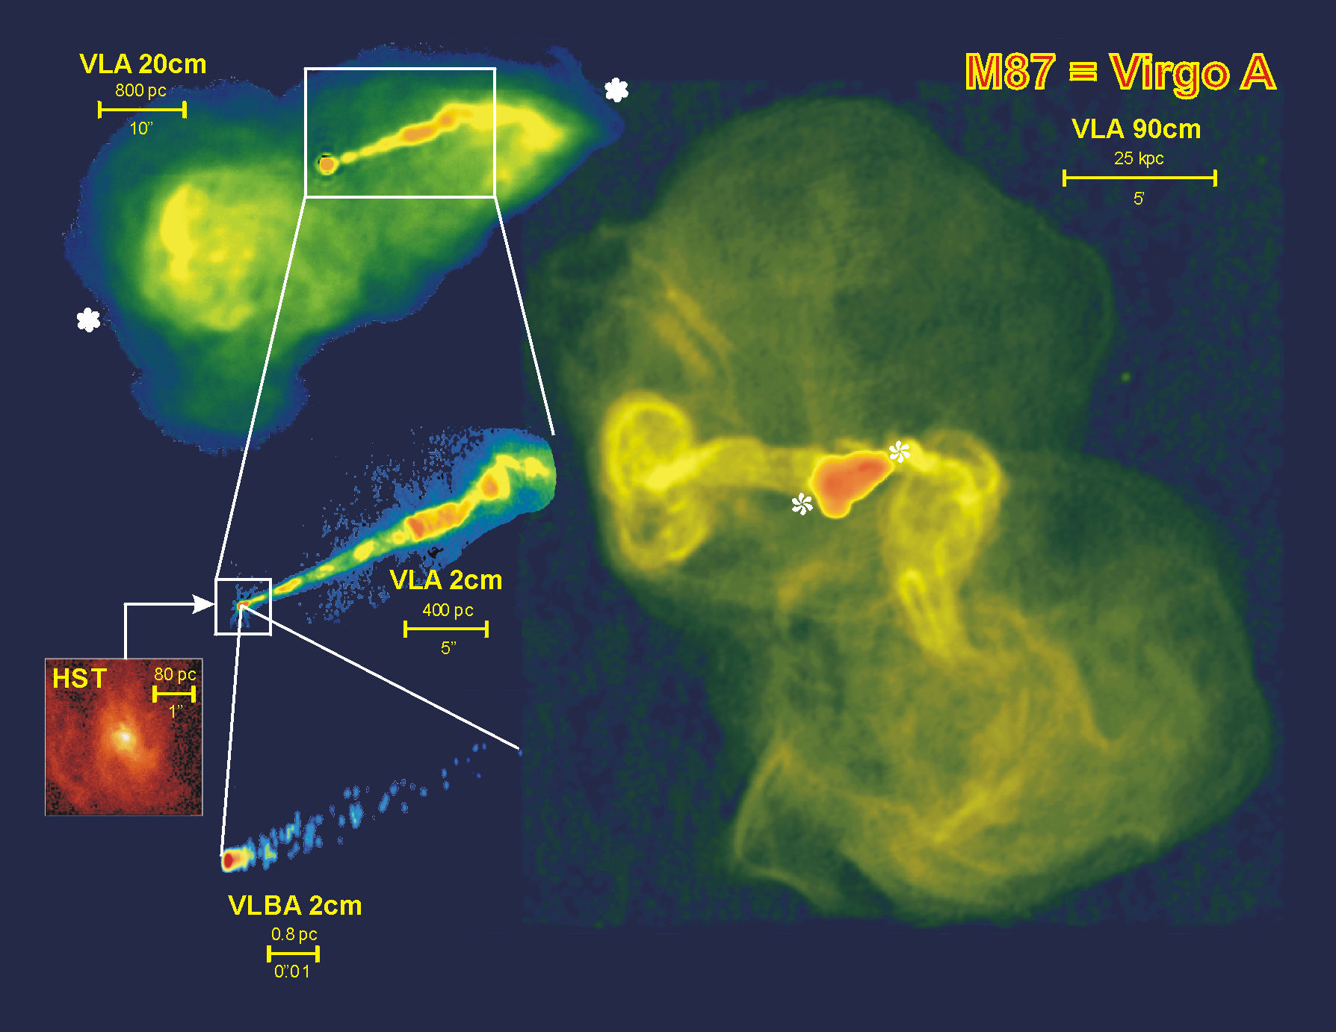

Slide 3
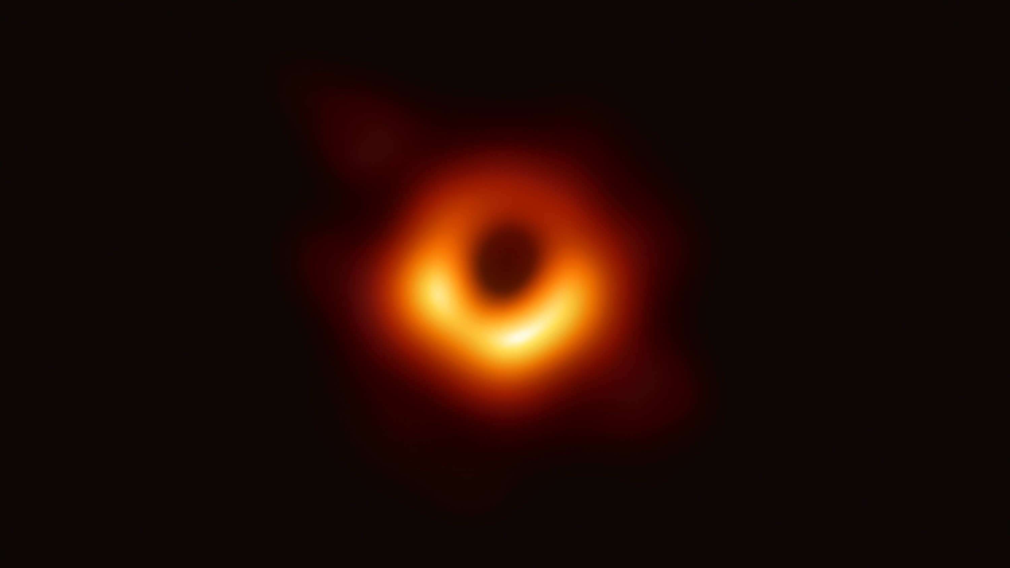
M87
42 μas
M_{BH}=6.5 +/- 0.7 x 10⁹ M_{sun}
First Image of a Black Hole

Slide 4
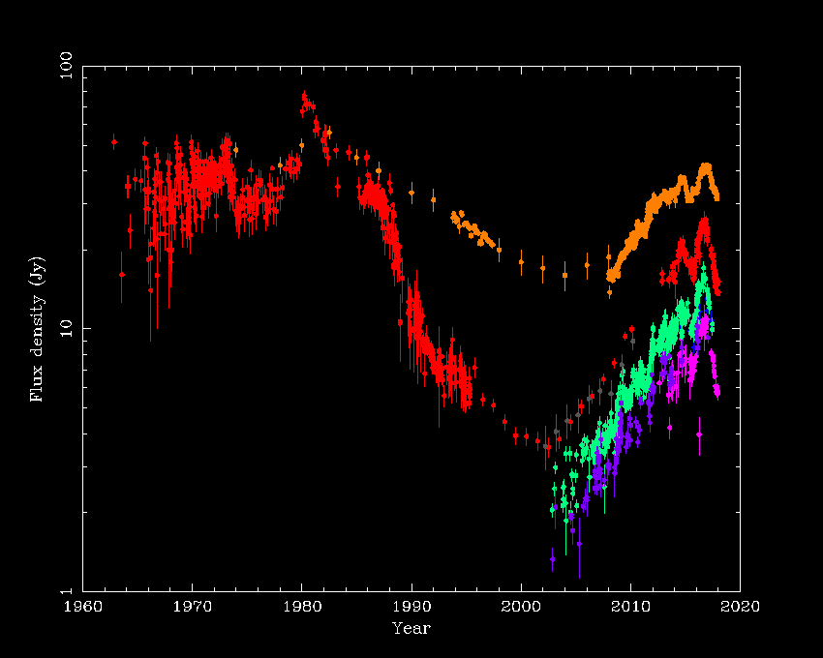
3C84 – over 60 years!
UMRAO + OVRO 15GHz
90GHz
230GHZ
350GHz
Alastair Edge

Slide 5
XR Binary Variability
Timescale is hours to days for state changes
Fender et al 2004

Slide 6
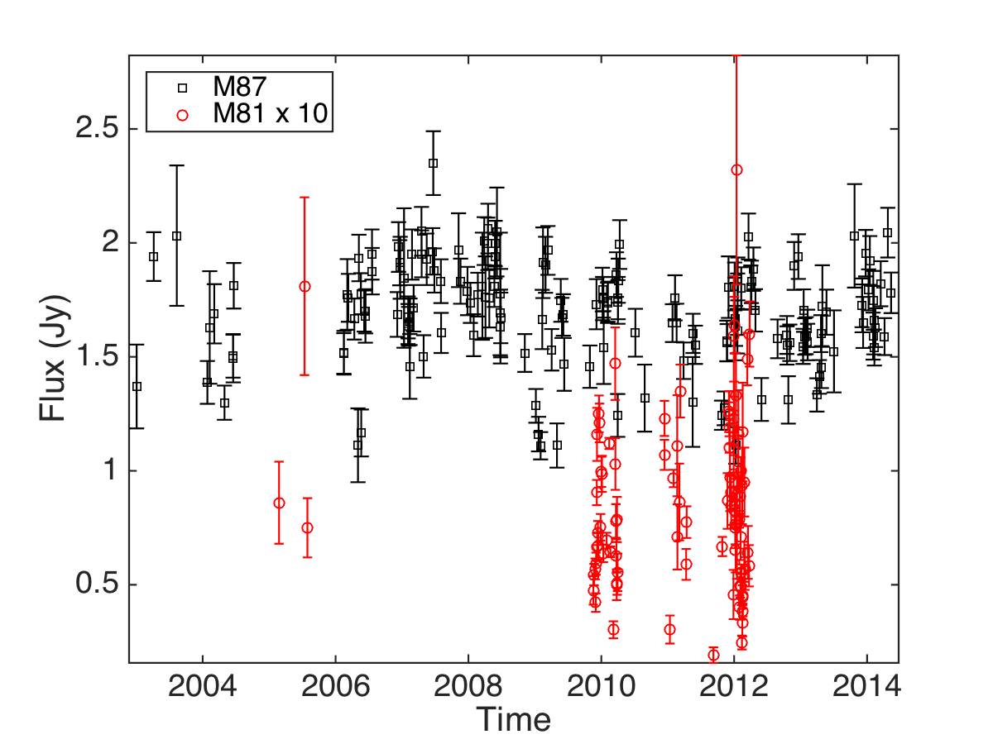
SMA M87 & M81 Lightcurves

Slide 7
AGN Variability

Slide 8
Black Hole Mass-Timescale Correlation
Notes:
The solid line gives the period for the innermost
stable circular orbit (ISCO); the dashed line gives the infall time for a disk with radius 5RS,
a viscosity = 1, and a height H=R = 1.

Slide 9
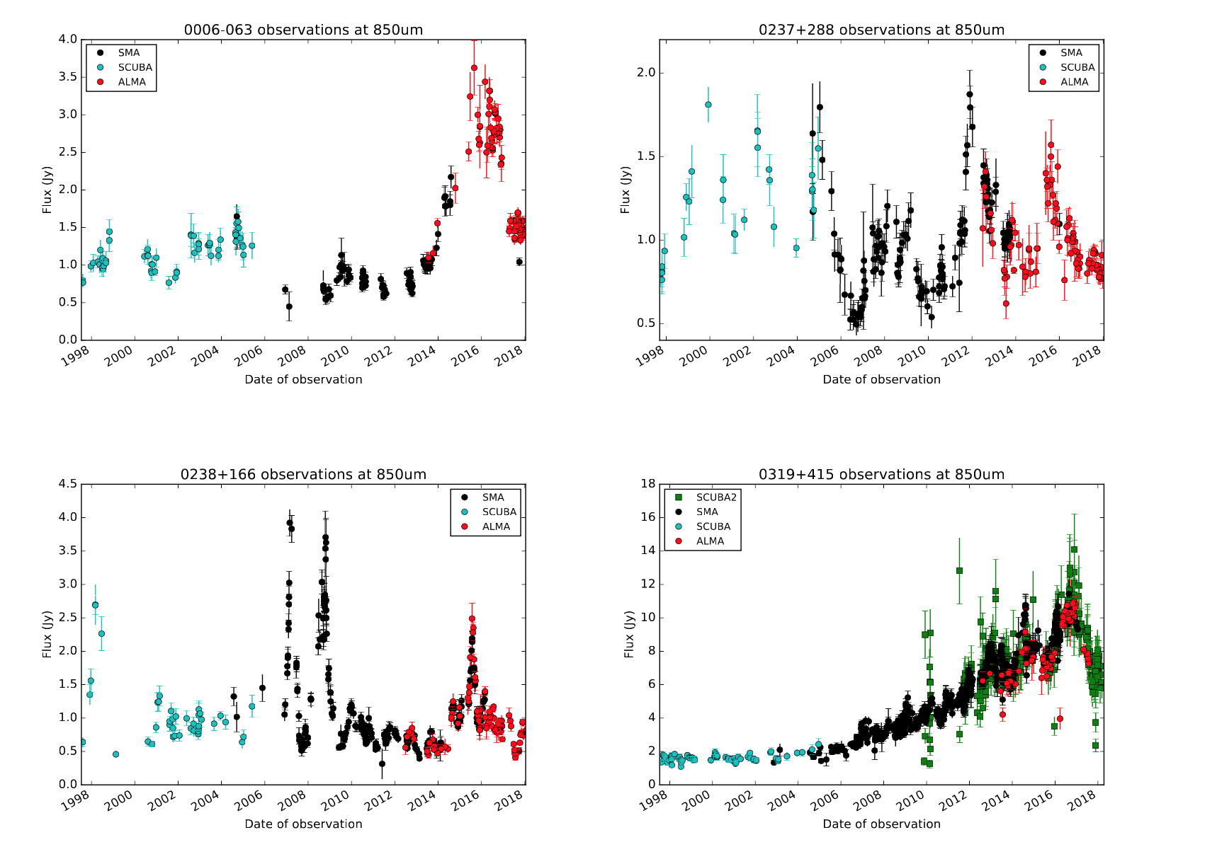
SCUBA: Jenness 2010
SMA: Gurwell
ALMA: ALMA
SCUBA2: This work

Slide 10
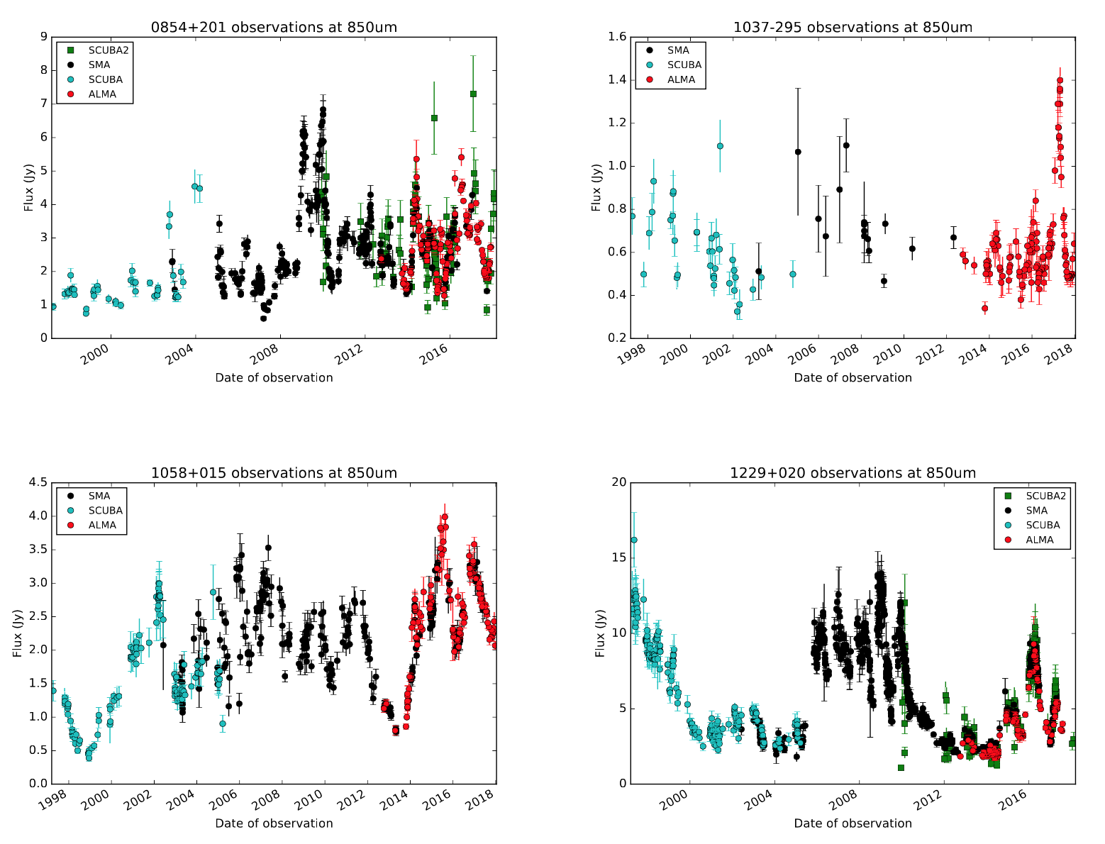

Slide 11
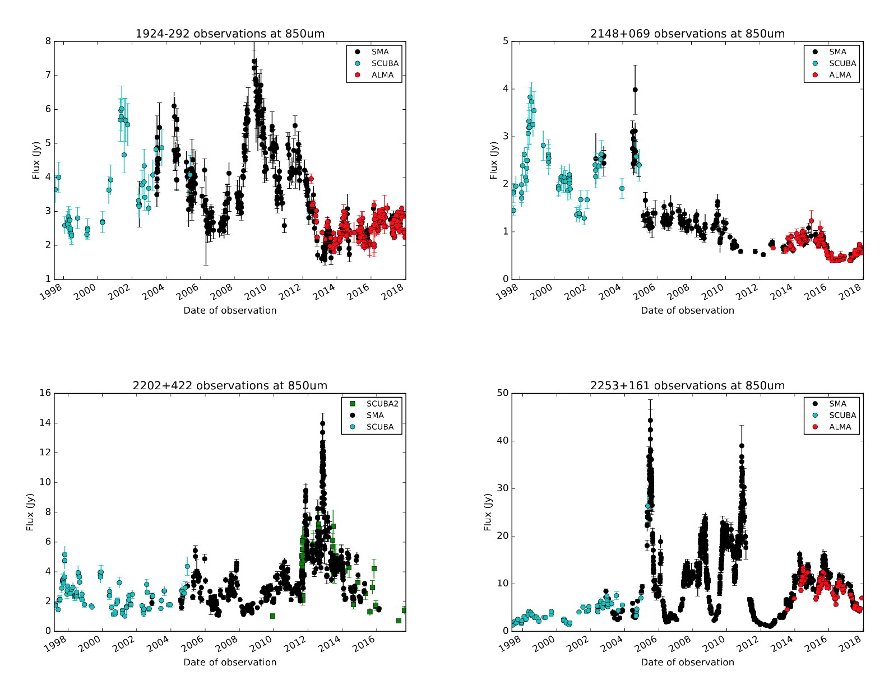

Slide 12
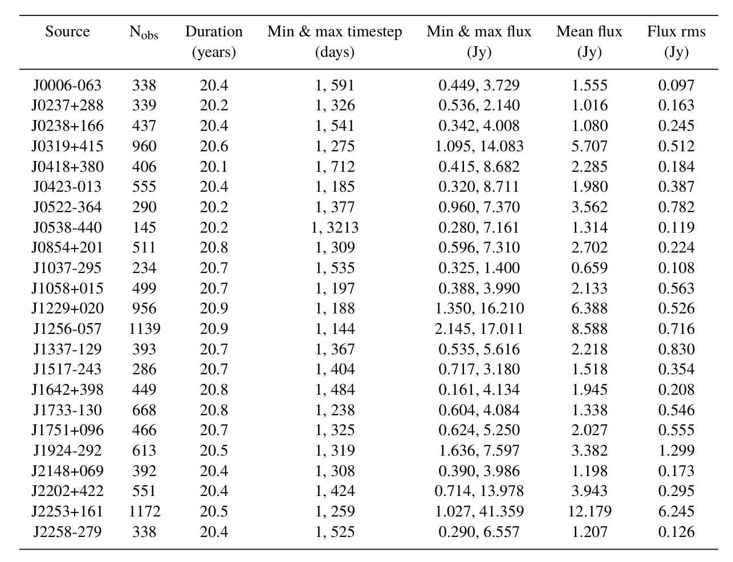

Slide 13
1751+096
2253+161

Slide 14
Summary
SCUBA, SMA, ALMA, SCUBA2 fluxes for 23 objects over 20 years
Strong agreement in calibration
Probes characteristic variability timescales
Work in progress…

